Slide 1

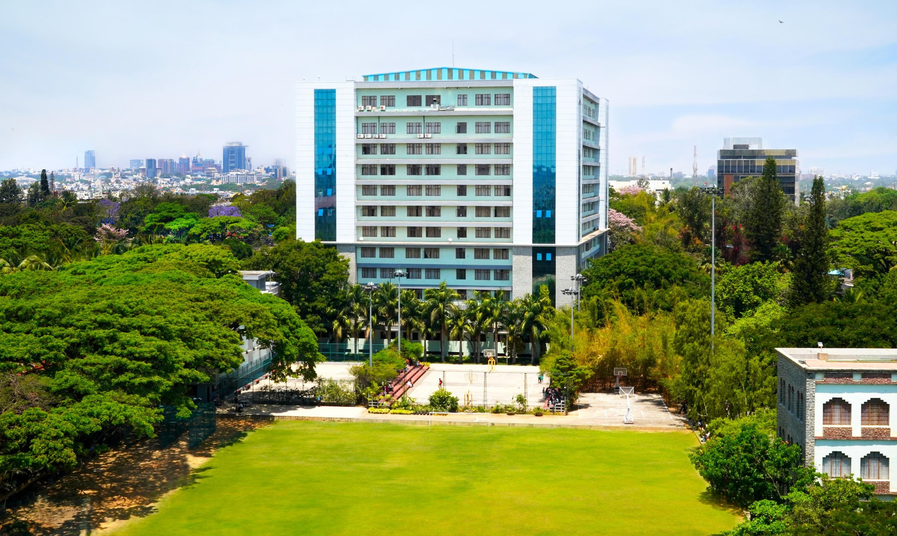
ff
Welcome

Slide 2
General Guidelines Pre-Joining
International Students arriving on a new visa are required to register with the local Foreign Regional Registration Office ( FRRO) within 14 days of their arrival . Assistance will be provided from the International Office if necessary .
International Students will be provided Bonafide Letters/Certificate from the International Office for Bank purposes and opening of Bank A/C,s .
Foreign Students will have to submit a C Form ( To be provided by the PG /Apartment Owner ) to the Foreign Regional Registration Office incase the student is residing outside the campus in PG Accommodation , Apartments etc However , for students living in the University premises will be given a C Form by the International Office .
Foreign students should have a valid passport , student visa and a valid residential permit during their stay in India . However , the residential permit is not applicable to students who are holding an OCI /PIO card and students from Nepal and Bhutan.
Foreign Student will not be permitted to attend classes at the University without valid documents

Slide 3
Students should maintain discipline at all times, both inside and outside the campus. Ragging is STRICTLY NOT ALLOWED.
Students have to adhere with the code of conduct on the campus which includes safeguarding the University property, keeping the place clean and following the prescribed dress code ( Formal Pant and Shirts, Salwar etc.) . Jeans pants and T –Shirts for Under Graduate , Post Graduate and Ph.D. Students will strictly not be allowed.
Smart Card issued by the University should be used for all transactions within the University including payment of fees and library access, etc.
Students are requested to respond to every mail that has been sent to them by the Office of International Affairs
Smoking and consumption of alcohol, drugs and other toxic substances of any kind is strictly prohibited inside the university campus.
All students are requested to wear their student identity card and also carry their smart card that will be issued to them by the University while entering the campus. No student will be permitted to enter the campus if the student fails to produce the student ID /smart card at the security gate.
Email ID and Contact Number for future communication need to be updated at the admission office.

Slide 4
The Student is strictly not allowed to argue with the security personnel, in case the security personnel does not allow the student to enter the gates at the entrance/building for being non- compliant with the norms of the University
University ID cards should not be exchanged with any other student nor should be given to anyone. Misusing of ID cards by students is not acceptable.
Students are requested to groom themselves well and dress modestly before entering the class/ university campus.
Fancy style colouring of hair, body piercing , tattooing, consuming alcohol and smoking etc is not permitted nor entertained .
Parents will be able to monitor the attendance.
Registration on STUDY IN INDIA (SII) is mandatory.

Slide 5
Leave Regulations:
Students must have a minimum of 85% attendance to be permitted to write the end semester examination. Leave applications will be updated only if the overall attendance is above 75% on the last working day.
The minimum attendance requirement as per the university norms is 85%. Students who fail to meet this required percentage of attendance will be detained in the current semester and will not be allowed to attend the classes for the following semester. Such students will have to repeat the semester and fulfil the required criteria to be eligible for promotion to the succeeding semester.
In reference to the FRRO registration students can claim attendance only if the FRRO officials have requested the student to meet them in person.
Students who are detained due to shortage of attendance will be considered for readmission only once during the period of their course of study at the University.
Students who need to be absent due to personal reasons shall apply with a duly filled in leave application form, with signatures from the respective faculty/HoD concerned.

Slide 6
Hostel Rules and Regulations (For students staying inside the University Campus)
Student resident have to register their out -time and in-time in the morning and evening via the biometric system.
Every student shall keep the room allotted to him neat and tidy. He should take proper care of the furniture and fixtures.
Allotment of the room, furniture and so forth will be entirely at the discretion of the Director of the hall.
Students are not permitted to change the room allotted to them, except at the discretion of the authorities of the hall.
The concerned authorities have the right to enter and inspect the rooms at any time, even in the absence of the students.
No poster should be put up anywhere, either in rooms or lobbies. In addition, the student should not drive nails, screws and so forth into the wall or doors.
Please carry a pillow, bedsheet and blanket cover incase you are living inside the University hostel

Slide 7
Office of International Affairs acts as a bridge between international students and the University administration, ensuring smooth integration into campus and life in India.

Slide 8

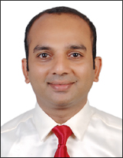

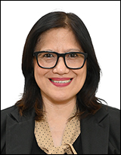


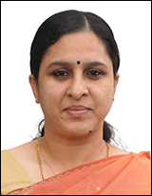


Team OIA
Mr. Selwyn Mascarenhas
Administrative Officer
International Admission, Student Welfare
Mr. Ravindra T
Student Services &
Mobility, FRRO
Ms. Joe-Ann Serrano
International Admission & Student Welfare
Mr. Dennison Joseph
Associate Director
Dr. Fr. Viju P. Devassy
Pro Vice-Chancellor
Director
Mr. Manoj Thomas
Coordinator,
Global Partnership,
Secretary to the Director
Ms. Jolly Joshy
International Exchange
& Scholarship
Ms. Bindu Verma
Student Mobility &
International University
Partnership
Mr.John Koshy
Hospitality &
Student Services

Slide 9

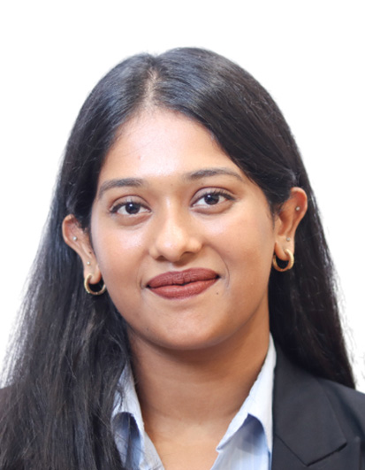
Team OIA
Ms. Archita R Nair
Office of International Affairs
Pune- Lavasa Campus
Ms. Kurunghat Ravi Priyanka
Office of International Affairs
Delhi - NCR Campus

Slide 10
Mobility & Exchange
Student Services & Welfare
India Gateway Training Programs
International Summer School
International Student Exchange
Credit Exchange Outgoing Students
Degree Seeking Outgoing Students
International Admission
FRRO Registration Guidance
International Students Welfare & Assistance
ICC Programs

Slide 11
”At CHRIST University, international students are not just welcomed —
they are supported, guided, and empowered to thrive academically, socially, and personally."

Slide 12
THANK YOU

